Slide 1
High performance Web Service Callouts on force.com

Slide 2
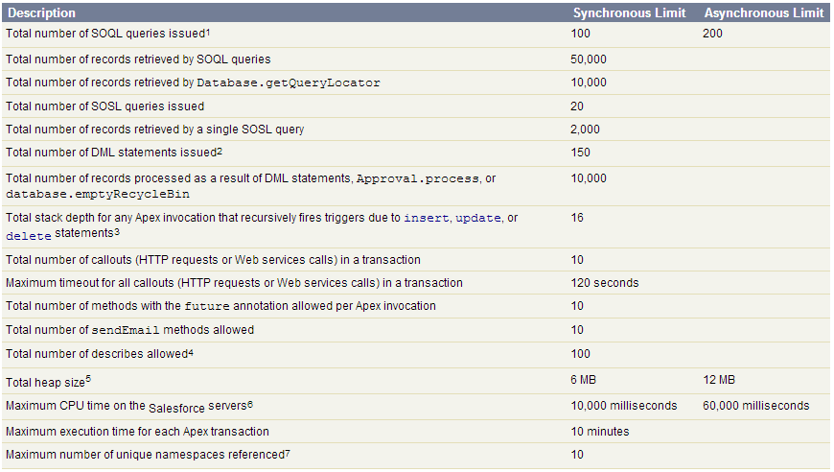
Problem #1
Per-Transaction limits

Slide 3
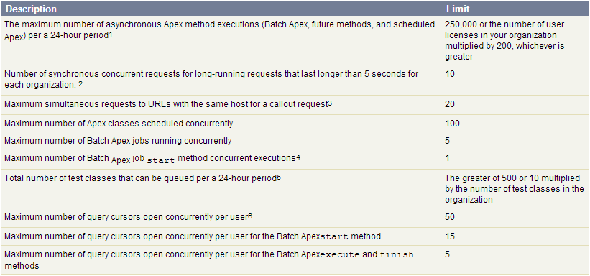
Problem #2
Platform limits

Slide 4
Native solution
HTTP: callout 1 callout 2 … callout 10
BACKLOG: callout 11 … callout 100
HTTP: callout 11 callout 12 … callout 20
BACKLOG: callout 21 … callout 100
HTTP: callout 91 callout 92 … callout 100
BACKLOG:
callout 1
callout 2
callout 3
…
callout 100
…

Slide 5
Native solution code demo
https://na15.salesforce.com
http://some.webservice.com/viewer.php

Slide 6
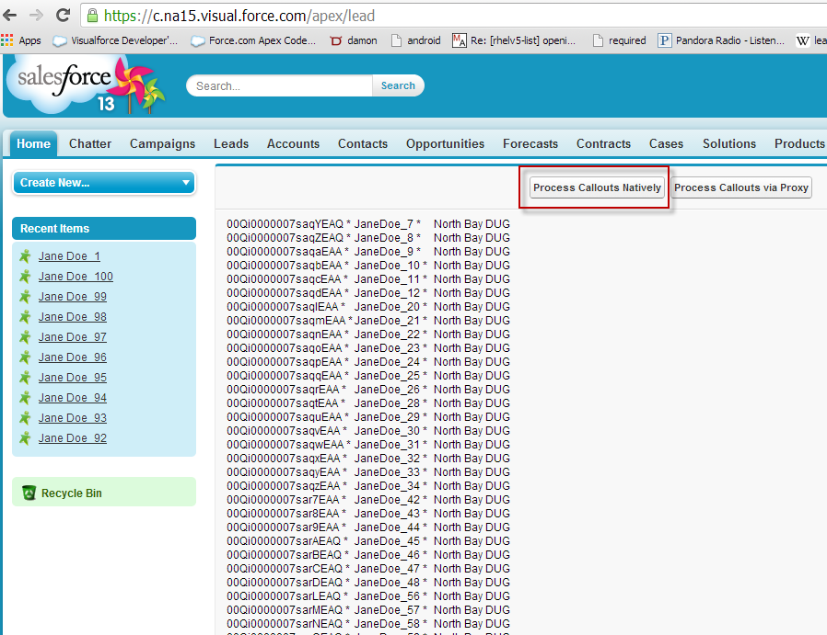
demo

Slide 7
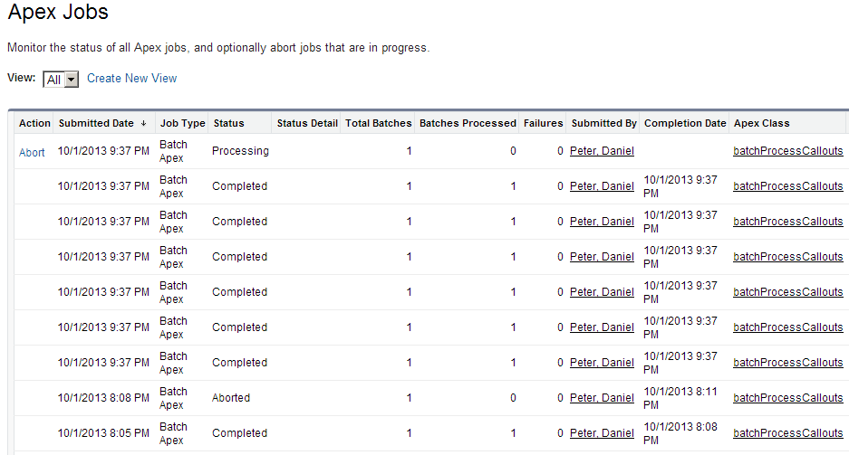
demo

Slide 8
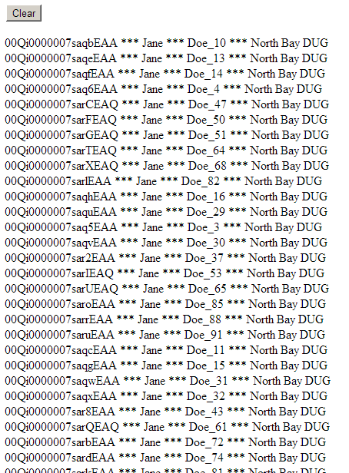
demo

Slide 9
Scalable, but slow.

Slide 10
Proxy solution
Receive full record data
1 callout
Infinite records
callout
proxy
Some web service
request full record data from IDs

Slide 11
Rolling curl
Smarter Implementation of php’s curl_multi_exec
https://code.google.com/p/rolling-curl

Slide 12
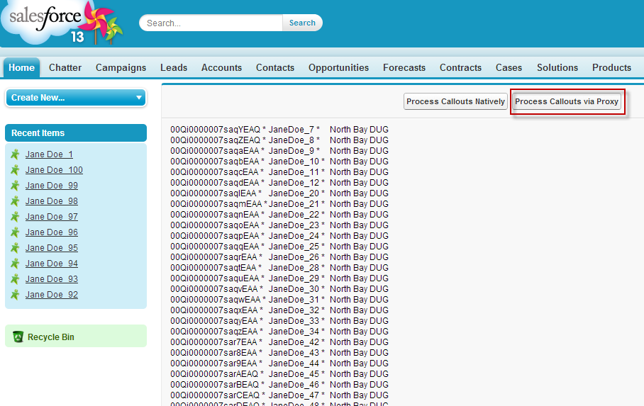
demo

Slide 13
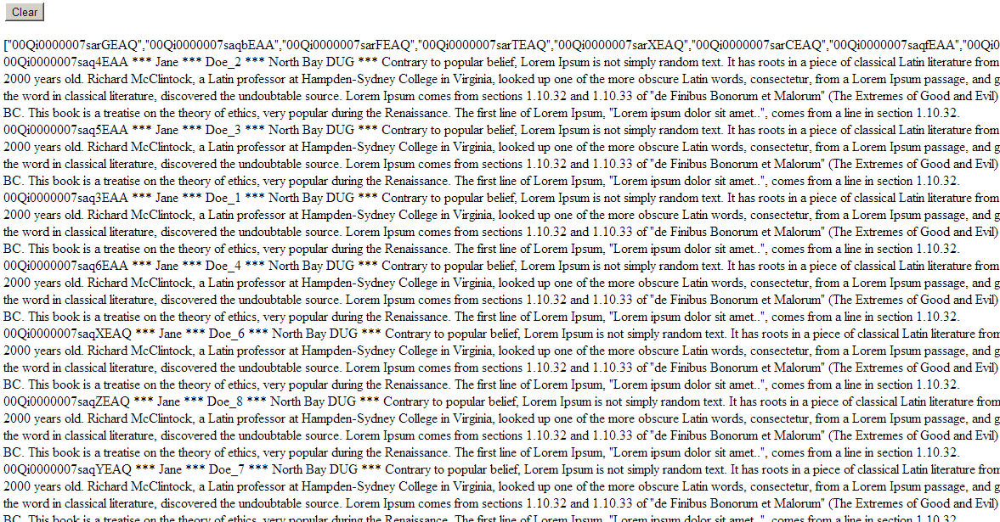

Slide 14
Demo code on github
https://github.com/danieljpeter/high_performance_force.com_callouts

Slide 15
Scalable, fast, but another thing to maintain.

Slide 16
Thanks! @danieljpeter

